Slide 1

Auction Abode
Hasnain Mahvia
Hafsa Saeed
Muhammad Ali Mahmood
Zakria Aftab Abbasi
Supervisor: Ms. Fakhar Un Nisa
Department of Computer Science
Barani Institute of Management Sciences, Rawalpindi

Slide 2
Introduction
Auction-Abode is an AI-powered real estate bidding platform that enables users to participate in property auctions online in real time.
Designed to bring transparency, efficiency, and automation to the property auction process.
Integrates AI-based price prediction and real-time bidding using modern web technologies.
Built using the MERN stack with Socket.io for live auction updates.
Aims to make property trading faster, safer, and more accessible for everyone.
Notes:
1- main usage social media
2- twitter facebook
3- usage of twiiter entertainment
4- share karty hain news without authentication of current affairs
5- schemers is ka faida uthaty hain yeah 1 thread ha
6- isko overcome karnay kay liay bohat say reserachers nay different techniques use ki hain isay overcome karny ky liay

Slide 3
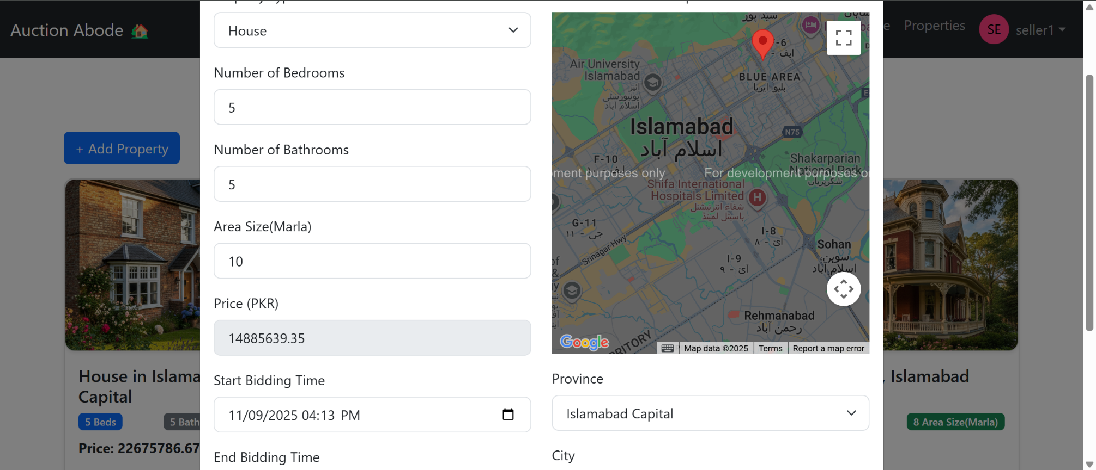
Auction-Abode – System Screens
Notes:
1- main usage social media
2- twitter facebook
3- usage of twiiter entertainment
4- share karty hain news without authentication of current affairs
5- schemers is ka faida uthaty hain yeah 1 thread ha
6- isko overcome karnay kay liay bohat say reserachers nay different techniques use ki hain isay overcome karny ky liay

Slide 4
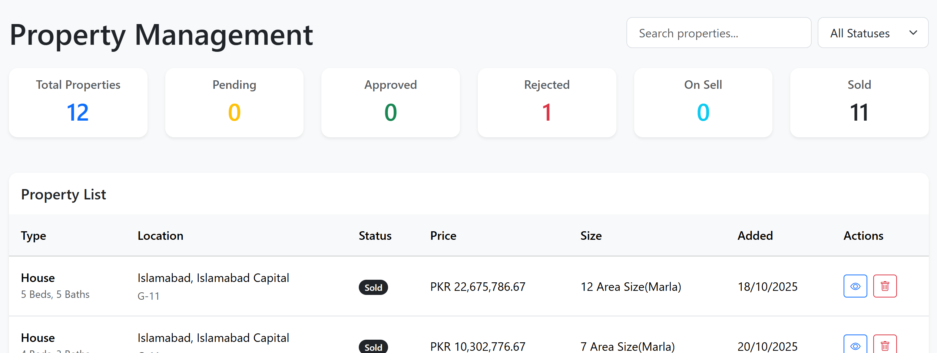
Auction-Abode – System Screens
Notes:
1- main usage social media
2- twitter facebook
3- usage of twiiter entertainment
4- share karty hain news without authentication of current affairs
5- schemers is ka faida uthaty hain yeah 1 thread ha
6- isko overcome karnay kay liay bohat say reserachers nay different techniques use ki hain isay overcome karny ky liay

Slide 5
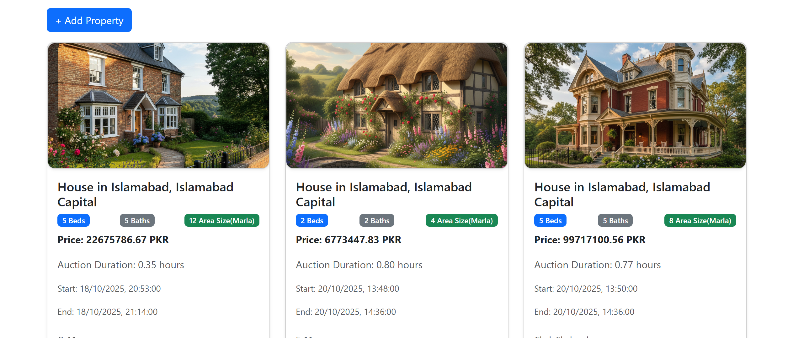
Auction-Abode – System Screens
Notes:
1- main usage social media
2- twitter facebook
3- usage of twiiter entertainment
4- share karty hain news without authentication of current affairs
5- schemers is ka faida uthaty hain yeah 1 thread ha
6- isko overcome karnay kay liay bohat say reserachers nay different techniques use ki hain isay overcome karny ky liay

Slide 6
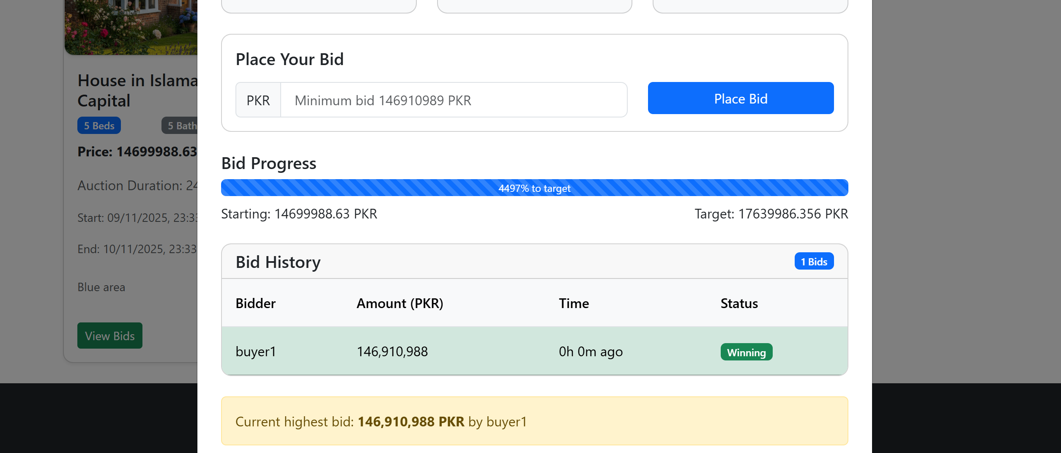
Auction-Abode – System Screens
Notes:
1- main usage social media
2- twitter facebook
3- usage of twiiter entertainment
4- share karty hain news without authentication of current affairs
5- schemers is ka faida uthaty hain yeah 1 thread ha
6- isko overcome karnay kay liay bohat say reserachers nay different techniques use ki hain isay overcome karny ky liay

Slide 7
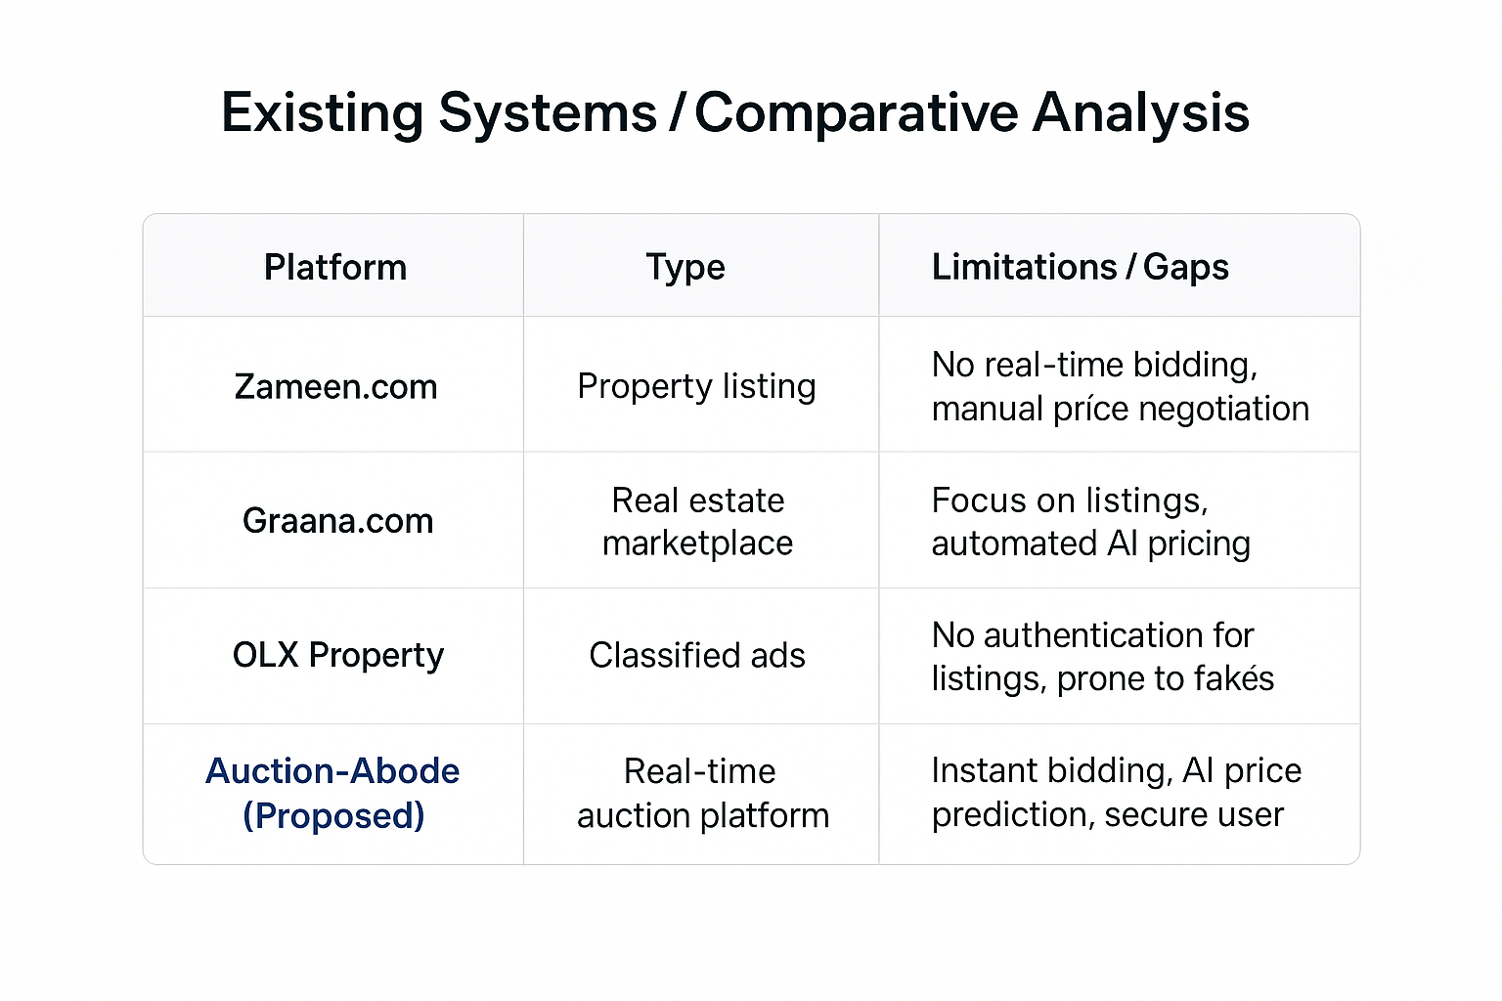
Existing Systems

Slide 8
Problem Statement
Traditional property auctions are often slow, location-bound, and manual.
Participants face bid manipulation and unfair competition due to lack of real-time updates.
Existing platforms lack real-time auction features — prices are negotiated manually.
Security and trust issues arise because user actions and bids aren’t properly verified or protected.
Buyers and sellers experience inefficient communication and delays in bid confirmation.
There’s a need for a fast, fair, and AI-assisted online bidding system that ensures transparency and ease of use.
Notes:
1- main usage social media
2- twitter facebook
3- usage of twiiter entertainment
4- share karty hain news without authentication of current affairs
5- schemers is ka faida uthaty hain yeah 1 thread ha
6- isko overcome karnay kay liay bohat say reserachers nay different techniques use ki hain isay overcome karny ky liay

Slide 9
Objectives
Develop a real-time property auction platform using modern web technologies.
Implement AI-based price prediction to guide users toward fair bidding decisions.
Ensure secure and transparent auctions through encrypted communication and verified user interactions.
Provide a responsive and user-friendly interface accessible across devices.
Enable smooth, scalable performance for multiple concurrent users during live auctions.
Notes:
1- main usage social media
2- twitter facebook
3- usage of twiiter entertainment
4- share karty hain news without authentication of current affairs
5- schemers is ka faida uthaty hain yeah 1 thread ha
6- isko overcome karnay kay liay bohat say reserachers nay different techniques use ki hain isay overcome karny ky liay

Slide 10
Proposed Solution
Real-Time Bidding: Uses Socket.io to update bids instantly for all participants, removing delays and fake updates..
AI-Based Price Prediction: AI model trained on historical data provides smart, data-driven price suggestions to guide users during bidding.
Secure Architecture: Implements JWT authentication and SSL encryption to ensure safe user sessions and transaction flow.
Notes:
1- main usage social media
2- twitter facebook
3- usage of twiiter entertainment
4- share karty hain news without authentication of current affairs
5- schemers is ka faida uthaty hain yeah 1 thread ha
6- isko overcome karnay kay liay bohat say reserachers nay different techniques use ki hain isay overcome karny ky liay

Slide 11
Proposed Solution
Scalable MERN Stack: Built using MongoDB, Express.js, React.js, and Node.js, allowing smooth performance with multiple concurrent users.
User-Friendly Interface: Clean and responsive UI designed for ease of use on desktop and mobile devices.
Notes:
1- main usage social media
2- twitter facebook
3- usage of twiiter entertainment
4- share karty hain news without authentication of current affairs
5- schemers is ka faida uthaty hain yeah 1 thread ha
6- isko overcome karnay kay liay bohat say reserachers nay different techniques use ki hain isay overcome karny ky liay

Slide 12
System Architecture
Frontend (Client Side):
Built with React.js, providing a responsive and interactive interface.
Connects to backend APIs and displays live auction data using Socket.io.
Backend (Server Side):
Developed with Node.js and Express.js.
Handles all auction logic, authentication, and communication between users and database.
Integrates AI model for intelligent price prediction.
Notes:
1- main usage social media
2- twitter facebook
3- usage of twiiter entertainment
4- share karty hain news without authentication of current affairs
5- schemers is ka faida uthaty hain yeah 1 thread ha
6- isko overcome karnay kay liay bohat say reserachers nay different techniques use ki hain isay overcome karny ky liay

Slide 13
System Architecture
Database Layer:
MongoDB stores user data, property details, and bidding history.
Connects to backend APIs and displays live auction data using Socket.io.
Real-Time Communication:
Socket.io provides live bid updates and notifications instantly.
Notes:
1- main usage social media
2- twitter facebook
3- usage of twiiter entertainment
4- share karty hain news without authentication of current affairs
5- schemers is ka faida uthaty hain yeah 1 thread ha
6- isko overcome karnay kay liay bohat say reserachers nay different techniques use ki hain isay overcome karny ky liay

Slide 14
Functional Requirements
User Management
Property Management
Auction System
AI-Based Price Prediction
Reporting
Notes:
1- main usage social media
2- twitter facebook
3- usage of twiiter entertainment
4- share karty hain news without authentication of current affairs
5- schemers is ka faida uthaty hain yeah 1 thread ha
6- isko overcome karnay kay liay bohat say reserachers nay different techniques use ki hain isay overcome karny ky liay

Slide 15
Non-Functional Requirements
Performance
Security
Scalability
Usability
Reliability
Maintainability
Compatibility
Notes:
1- main usage social media
2- twitter facebook
3- usage of twiiter entertainment
4- share karty hain news without authentication of current affairs
5- schemers is ka faida uthaty hain yeah 1 thread ha
6- isko overcome karnay kay liay bohat say reserachers nay different techniques use ki hain isay overcome karny ky liay

Slide 16
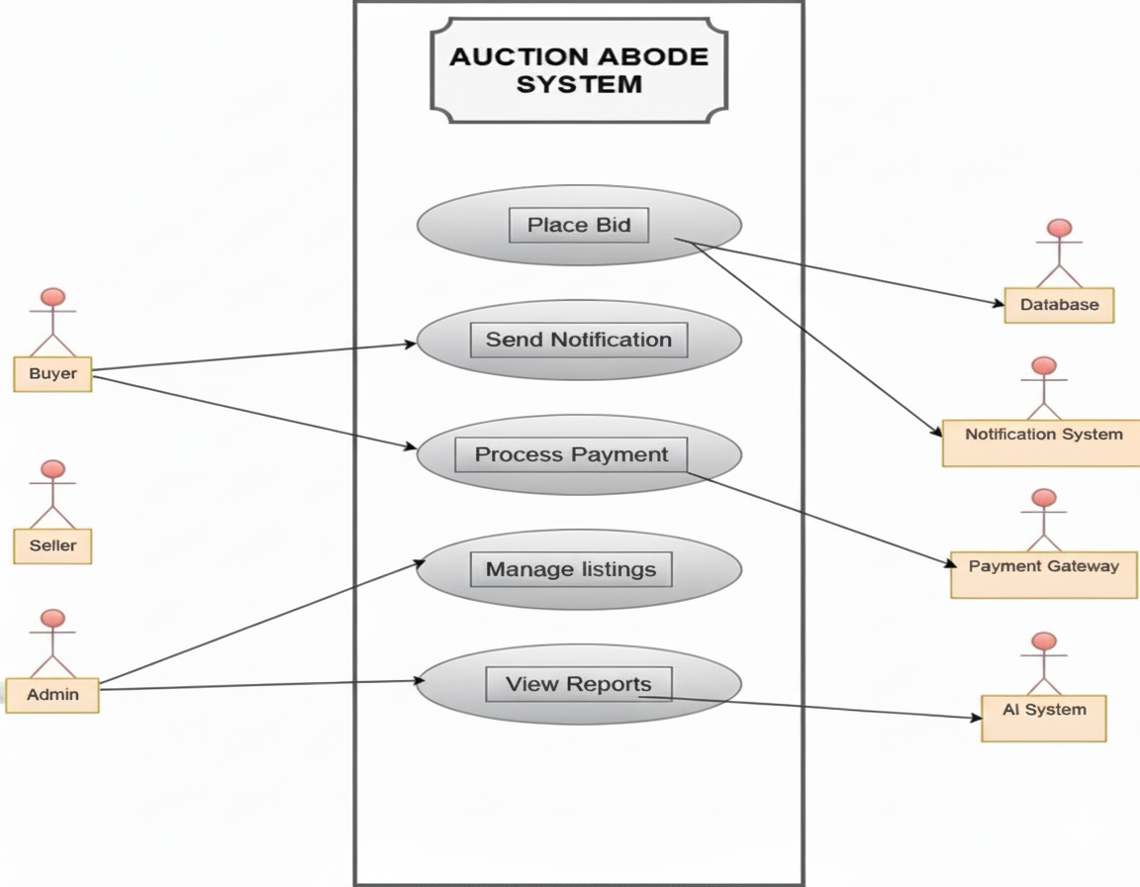

Use Case Model

Slide 17
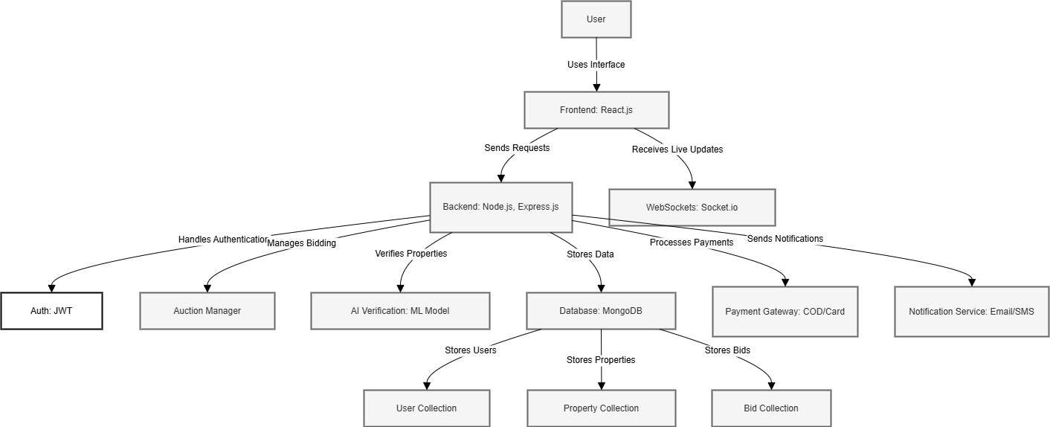
System Architecture

Slide 18
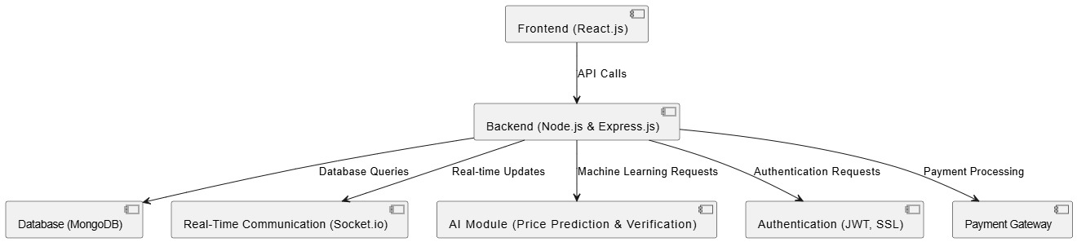
Component Diagram

Slide 19
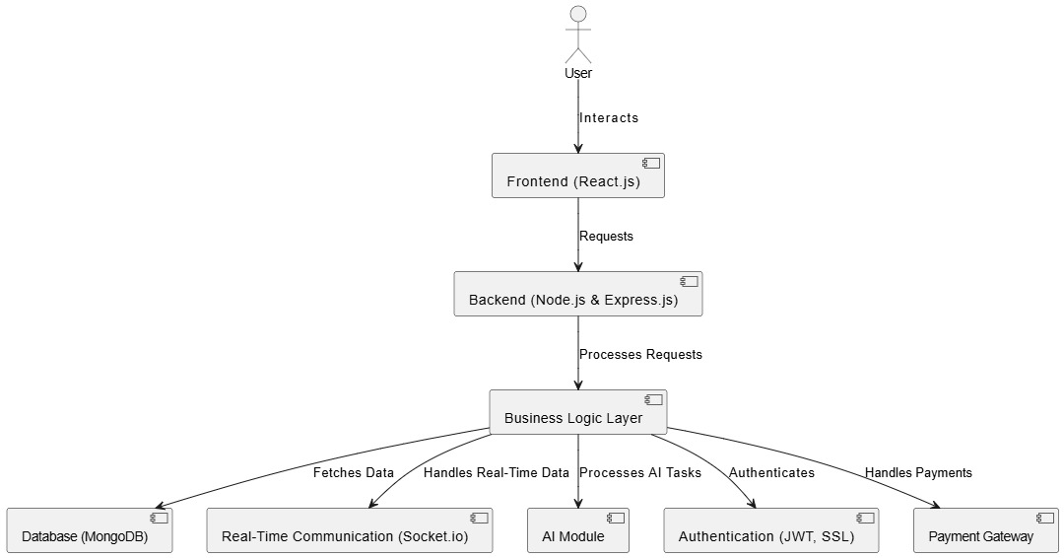
System Component Diagram

Slide 20
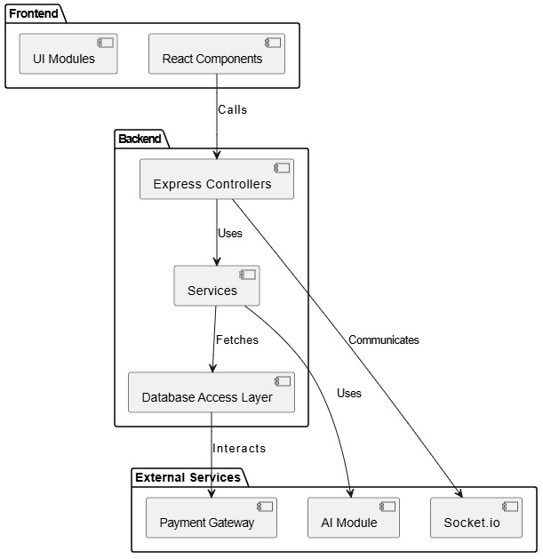
Package Diagram

Slide 21
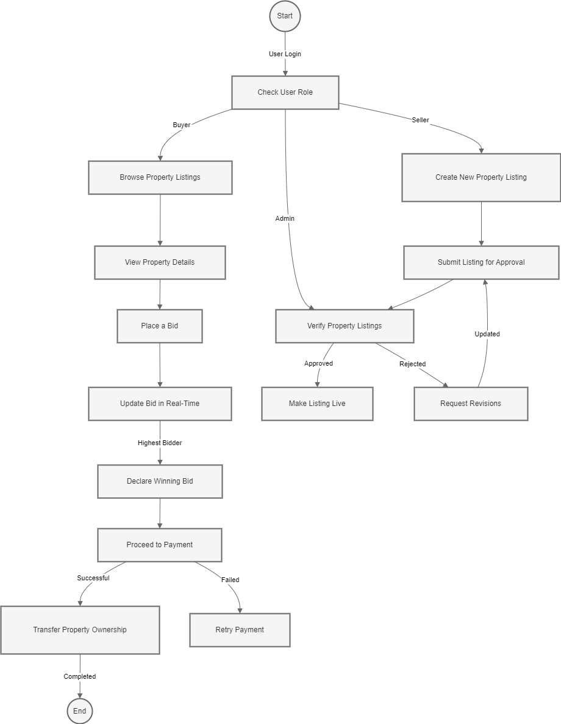
Activity Diagrams

Slide 22
Thank You !
Auction-Abode: Smart, Secure, and Real-Time Property Bidding.

